Slide 1
chapter 6 Linear model selection and regularization

Slide 2

In the chapters that follow, we consider some approaches for extending the linear model framework. In Chapter 7 we generalize (6.1) in order to accommodate non-linear, but still additive, relationships, while in Chapter 8 we consider even more general non-linear models.
Hence, before moving to the non-linear world, we discuss in this chapter some ways in which the simple linear model can be improved, by replacing plain least squares fitting with some alternative fitting procedures.

Slide 3
Prediction Accuracy
If n >>p that is, if n, the number of observations, is much larger than p, the number of variables—then the least squares estimates tend to also have low variance, and hence will perform well on test observations.
And if p > n, then there is no longer a unique least squares coefficient estimate: the variance is infinite so the method cannot be used at all.
By constraining or shrinking the estimated coefficients, we can often substantially reduce the variance at the cost of a negligible increase in bias.

Slide 4
Model Interpretability
It is often the case that some or many of the variables used in a multiple regression model are in fact not associated with the response. Including such irrelevant variables leads to unnecessary complexity in the resulting model.
By removing these variables—that is, by setting the corresponding coefficient estimates to zero—we can obtain a model that is more easily interpreted.
In this chapter, we see some approaches for automatically performing feature selection or variable selection

Slide 5
In this chapter, we discuss three important classes of methods. Subset Selection. This approach involves identifying a subset of the p predictors that we believe to be related to the response.
Shrinkage. This approach involves fitting a model involving all p predictors. However, the estimated coefficients are shrunken towards zero relative to the least squares estimates.
Dimension Reduction. This approach involves projecting the p predictors into a M-dimensional subspace, where M < p.

Slide 6
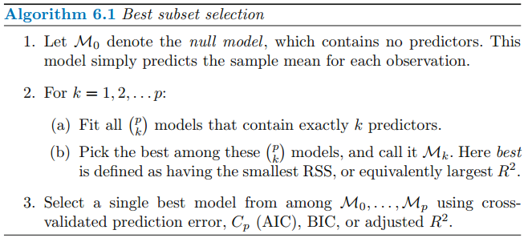
6.1 Subset Selection 6.1.1 Best Subset Selection

Slide 7
Step 2 identifies the best model (on the training data) for each subset size, in order to reduce the problem from one of 2^p possible models to one of p + 1 possible models. The problem is that a low RSS or a high R2 indicates a model with a low training error, whereas we wish to choose a model that has a low test error. Therefore, in Step 3, we use cross-validated prediction error, Cp, BIC, or adjusted R2 in order to select among M0, M1, . . . , Mp.

Slide 8
6.1.2 Stepwise Selection
For computational reasons, best subset selection cannot be applied with very large p. Best subset selection may also suffer from statistical problems when p is large.
Forward Stepwise Selection
Backward Stepwise Selection
Hybrid Approaches

Slide 9
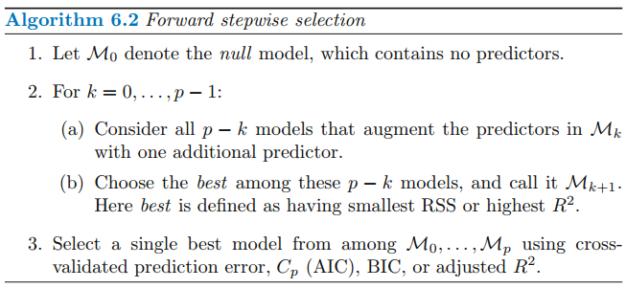
Forward Stepwise Selection

Slide 10
Unlike best subset selection, which involved fitting 2^p models, forward stepwise selection involves fitting one null model, along with p − k models in the kth iteration, for k = 0, . . . , p − 1. This amounts to a total of 1 + p(p+ 1)/2 models.
This is a substantial difference: when p = 20, best subset selection requires fitting 1,048,576 models, whereas forward stepwise selection requires fitting only 211 models.

Slide 11
Forward stepwise selection’s computational advantage over best subset selection is clear. Though forward stepwise tends to do well in practice, it is not guaranteed to find the best possible model out of all 2^p models containing subsets of the p predictors.
Forward stepwise selection can be applied even in the high-dimensional setting where n < p; however, in this case, it is possible to construct submodels M0, . . . , Mn−1 only, since each submodel is fit using least squares, which will not yield a unique solution if p ≥ n.

Slide 12
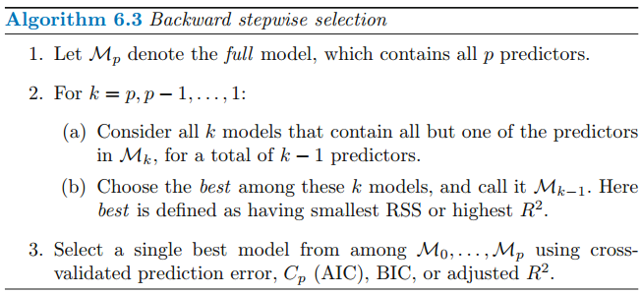
Backward Stepwise Selection

Slide 13
Like forward stepwise selection, the backward selection approach searches through only 1+p(p+1)/2 models, and so can be applied in settings where p is too large to apply best subset selection. Also like forward stepwise selection, backward stepwise selection is not guaranteed to yield the best model containing a subset of the p predictors.
Backward selection requires that the number of samples n is larger than the number of variables p (so that the full model can be fit). In contrast, forward stepwise can be used even when n < p, and so is the only viable subset method when p is very large.

Slide 14
Hybrid Approaches
The best subset, forward stepwise, and backward stepwise selection approaches generally give similar but not identical models.
As another alternative, hybrid versions of forward and backward stepwise selection are available, in which variables are added to the model sequentially, in analogy to forward selection. However, after adding each new variable, the method may also remove any variables that no longer provide an improvement in the model fit.

Slide 15
6.1.3 Choosing the Optimal Model
In order to implement these methods, we need a way to determine which of these models is best.
In order to select the best model with respect to test error, we need to estimate this test error. There are two common approaches: 1. We can indirectly estimate test error by making an adjustment to the training error to account for the bias due to overfitting. 2. We can directly estimate the test error, using either a validation set approach or a cross-validation approach

Slide 16




Cp, AIC, BIC, and Adjusted R2

Slide 17
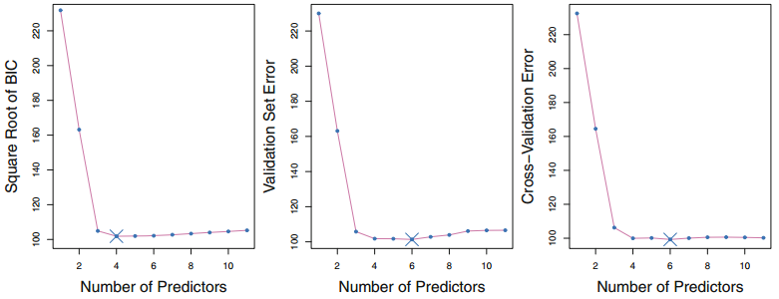
Validation and Cross-Validation

Slide 18
6.2 Shrinkage Methods
The subset selection methods described in Section 6.1 involve using least squares to fit a linear model that contains a subset of the predictors.
As an alternative, we can fit a model containing all p predictors using a technique that constrains or regularizes the coefficient estimates, or equivalently, that shrinks the coefficient estimates towards zero.

Slide 19

6.2.1 Ridge Regression
However, the second term, called a shrinkage penalty, is shrinkage small when β1, . . . , βp are close to zero, and so it has the effect of shrinking penalty the estimates of βj towards zero.

Slide 20
The tuning parameter λ serves to control the relative impact of these two terms on the regression coefficient estimates. When λ = 0, the penalty term has no effect, and ridge regression will produce the least squares estimates. However, as λ → ∞, the impact of the shrinkage penalty grows, and the ridge regression coefficient estimates will approach zero. Selecting a good value for λ is critical; we defer this discussion to Section 6.2.3, where we use cross-validation.

Slide 21
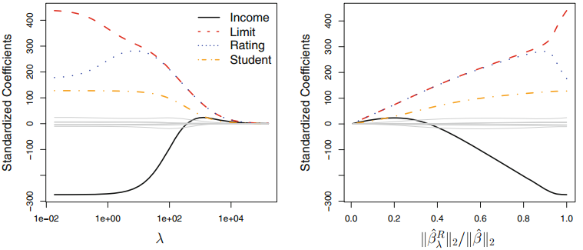

Slide 22
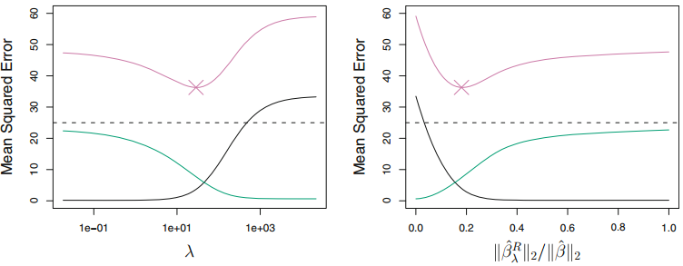
Why Does Ridge Regression Improve Over Least Squares?
Ridge regression’s advantage over least squares is rooted in the bias-variance trade-off. As λ increases, the flexibility of the ridge regression fit decreases, leading to decreased variance but increased bias.

Slide 23
6.2.2 The Lasso
Ridge regression does have one obvious disadvantage. The penalty will shrink all of the coefficients towards zero, but it will not set any of them exactly to zero (unless λ = ∞). This may not be a problem for prediction accuracy, but it can create a challenge in model interpretation in settings in which the number of variables p is quite large.

Slide 24

As with ridge regression, the lasso shrinks the coefficient estimates towards zero. However, in the case of the lasso, the L1 penalty has the effect of forcing some of the coefficient estimates to be exactly equal to zero when the tuning parameter λ is sufficiently large. Hence, much like best subset selection, the lasso performs variable selection.

Slide 25
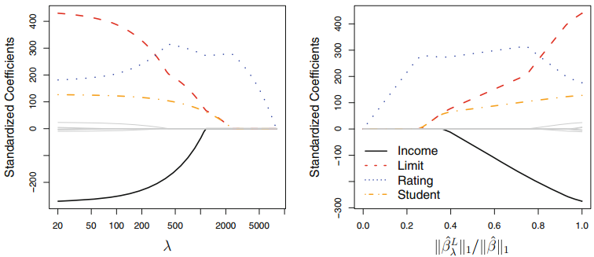
As a result, models generated from the lasso are generally much easier to interpret than those produced by ridge regression. We say that the lasso yields sparse models—that is, sparse models that involve only a subset of the variables.

Slide 26
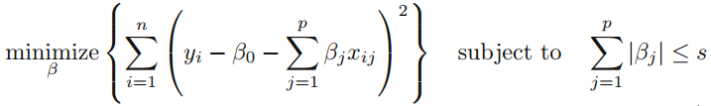
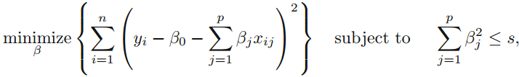
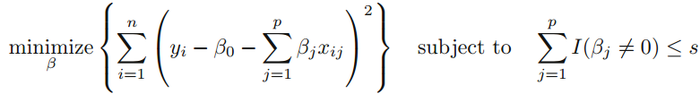
Another Formulation for Ridge Regression and the Lasso

Slide 27
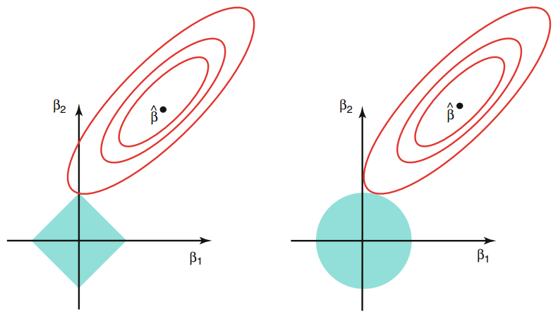
The Variable Selection Property of the Lasso

Slide 28
Comparing the Lasso and Ridge Regression
It is clear that the lasso has a major advantage over ridge regression, in that it produces simpler and more interpretable models that involve only a subset of the predictors. However, which method leads to better prediction accuracy? In this example, the lasso and ridge regression result in almost identical biases. However, the variance of ridge regression is slightly lower than the variance of the lasso. Consequently, the minimum MSE of ridge regression is slightly smaller than that of the lasso.

Slide 29
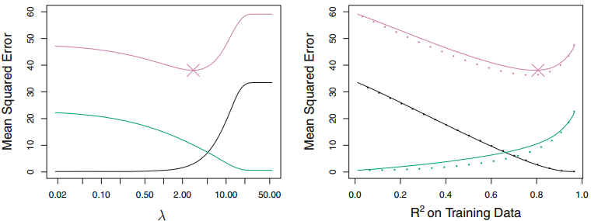

Slide 30



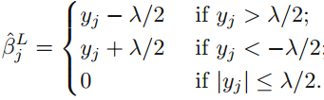
A Simple Special Case for Ridge Regression and the Lasso
In order to obtain a better intuition about the behavior of ridge regression and the lasso, consider a simple special case with n = p, and X a diagonal matrix with 1’s on the diagonal and 0’s in all off-diagonal elements.

Slide 31
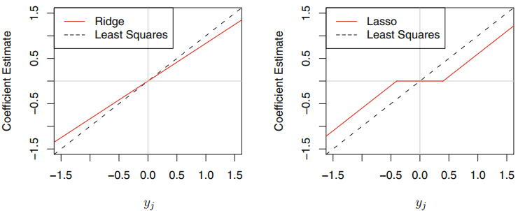

Slide 32
6.2.3 Selecting the Tuning Parameter
Cross-validation provides a simple way to tackle this problem.
We choose a grid of λ values, and compute the cross-validation error for each value of λ, as described in Chapter 5.
We then select the tuning parameter value for which the cross-validation error is smallest.
Finally, the model is re-fit using all of the available observations and the selected value of the tuning parameter.

Slide 33
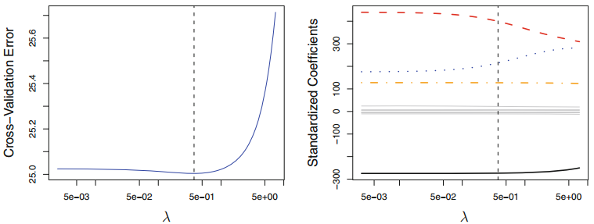

Slide 34
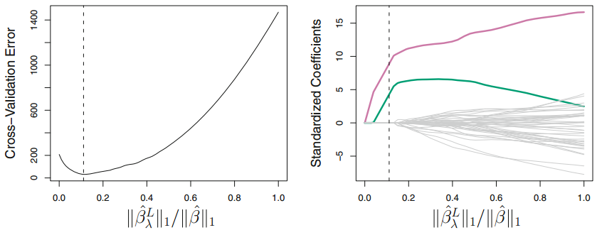

Slide 35
6.3 Dimension Reduction Methods
We now explore a class of approaches that transform the predictors and then fit a least squares model using the transformed variables. We will refer to these techniques as dimension reduction methods.
Principal Components Regression Partial Least Squares

Slide 36


Let Z_1, Z_2, . . . , Z_M represent M < p linear combinations of our original p predictors. That is,
for some constants φ_1m, φ_2m . . . , φ_pm, m = 1, . . ., M. We can then fit the linear regression model
If the constants φ_1m, φ_2m, . . . , φ_pm are chosen wisely, then such dimension reduction approaches can often outperform least squares regression.

Slide 37
The term dimension reduction comes from the fact that this approach reduces the problem of estimating the p+1 coefficients β0, β1, . . . , βp to the simpler problem of estimating the M + 1 coefficients θ0, θ1, . . . , θM , where M < p. In other words, the dimension of the problem has been reduced from p + 1 to M + 1.

Slide 38
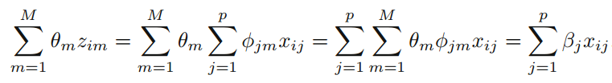


Slide 39
This constraint on the form of the coefficients has the potential to bias the coefficient estimates. However, in situations where p is large relative to n, selecting a value of M<<p can significantly reduce the variance of the fitted coefficients. If M = p, and all the Zm are linearly independent, then no dimension reduction occurs, and is equivalent to performing least squares on the original p predictors.

Slide 40
6.3.1 Principal Components Regression
Principal components analysis (PCA) is a popular approach for deriving a low-dimensional set of features from a large set of variables.
Here we describe its use as a dimension reduction technique for regression.

Slide 41
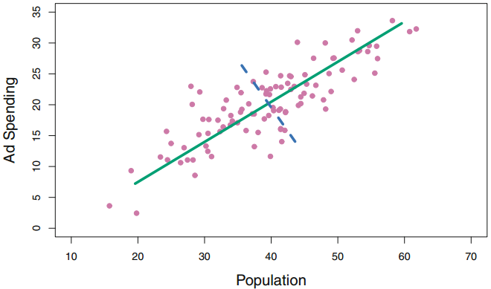
An Overview of Principal Components Analysis
PCA is a technique for reducing the dimension of a n × p data matrix X. The first principal component direction of the data is that along which the observations vary the most.

Slide 42
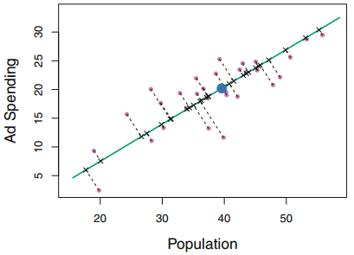
There is also another interpretation for PCA: the first principal component vector defines the line that is as close as possible to the data.

Slide 43
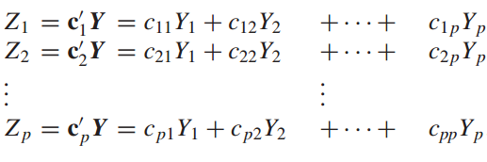





PCA algorithm

Slide 44




The first component

Slide 45



The second component

Slide 46
The Principal Components Regression Approach
The principal components regression (PCR) approach involves constructing the first M principal components, Z1, . . . , ZM, and then using these components as the predictors in a linear regression model that is fit using least squares.
The key idea is that often a small number of principal components suffice to explain most of the variability in the data, as well as the relationship with the response.

Slide 47
In other words, we assume that the directions in which X1, . . . , Xp show the most variation are the directions that are associated with Y. While this assumption is not guaranteed to be true, it often turns out to be a reasonable enough approximation to give good results.
If the assumption underlying PCR holds, then fitting a least squares model to Z1, . . . , ZM will lead to better results than fitting a least squares model to X1, . . . , Xp, since most or all of the information in the data that relates to the response is contained in Z1, . . . , ZM, and by estimating only M << p coefficients we can mitigate overfitting.

Slide 48
While PCR often performs quite well in many practical settings, it does not result in the development of a model that relies upon a small set of the original features. In this sense, PCR is more closely related to ridge regression than to the lasso. In fact, one can show that PCR and ridge regression are very closely related. One can even think of ridge regression as a continuous version of PCR!

Slide 49
6.3.2 Partial Least Squares
The PCR approach that we just described involves identifying linear combinations, or directions, that best represent the predictors X1, . . . , Xp. Thesedirections are identified in an unsupervised way, since the response Y is not used to help determine the principal component directions.
Consequently, PCR suffers from a drawback: there is no guarantee that thedirections that best explain the predictors will also be the best directions to use for predicting the response.
We now present partial least squares (PLS), a supervised alternative to PCR.

Slide 50
PLS algorithm
In computing Z1, PLS places the highest weight on the variables that are most strongly related to the response.
To identify the second PLS direction we first adjust each of the variables for Z1, by regressing each variable on Z1 and taking residuals. We then compute Z2 using this orthogonalized data in exactly the same fashion as Z1 was computed based on the original data. This iterative approach can be repeated M times to identify multiple PLS components Z1, . . . , ZM .
Finally, at the end of this procedure, we use least squares to fit a linear model to predict Y using Z1, . . . , ZM in exactly the same fashion as for PCR.

Slide 51
Code : Best Subset Selection
library (ISLR )
attach ( Hitters )
Hitters =na.omit ( Hitters )
library ( leaps )
regfit.full= regsubsets ( Salary~., data=Hitters ,nvmax =19)
reg.summary = summary ( regfit.full)
reg.summary$bic
coef( regfit.full ,6)

Slide 52
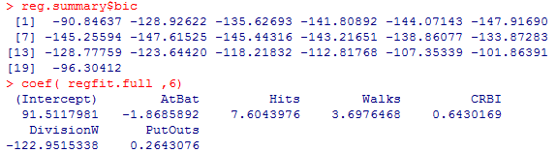

Slide 53
6.5.2 Forward Stepwise Selection
library (ISLR )
attach( Hitters )
Hitters =na.omit ( Hitters )
library ( leaps )
regfit.fwd = regsubsets ( Salary~., data= Hitters , nvmax =19, method ="forward")
fwd.summary = summary ( regfit.fwd )
fwd.summary$bic
coef( regfit.fwd ,6)

Slide 54
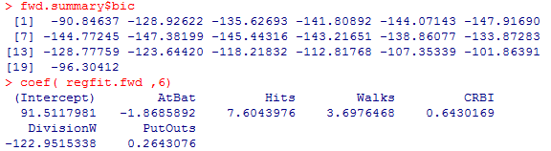

Slide 55
Code : Ridge Regression
library (ISLR )
attach ( Hitters )
Hitters =na.omit ( Hitters )
library ( glmnet )
x = model.matrix ( Salary~., Hitters )[,-1]
y = Hitters$Salary
set.seed (1)
cv.out =cv.glmnet(x, y, alpha =0)
plot(cv.out )
bestlam =cv.out$lambda.min
bestlam
result =glmnet (x,y, alpha =0, lambda = bestlam)
result$beta

Slide 56
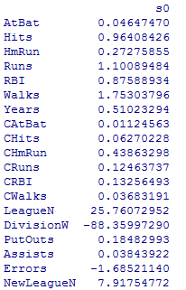
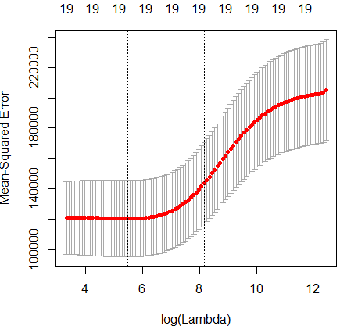

Slide 57
Code : The Lasso
library (ISLR )
attach ( Hitters )
Hitters =na.omit ( Hitters )
library ( glmnet )
x = model.matrix ( Salary~., Hitters )[,-1]
y = Hitters$Salary
set.seed (1)
cv.out =cv.glmnet(x, y, alpha =1)
plot(cv.out )
bestlam =cv.out$lambda.min
bestlam
result =glmnet (x,y, alpha =1, lambda = bestlam)
result$beta

Slide 58
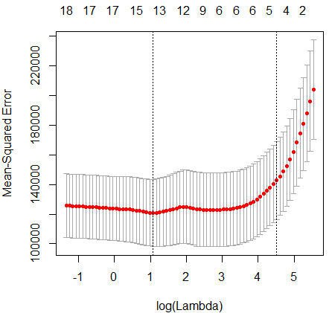
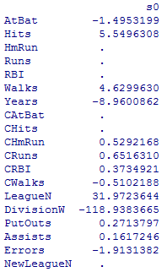

Slide 59
Code : Principal Components Regression
library (ISLR )
library (pls )
set.seed (2)
pcr.fit = pcr ( Salary~., data= Hitters , scale =TRUE , validation ="CV")
summary (pcr.fit )
validationplot(pcr.fit ,val.type ="MSEP")

Slide 60
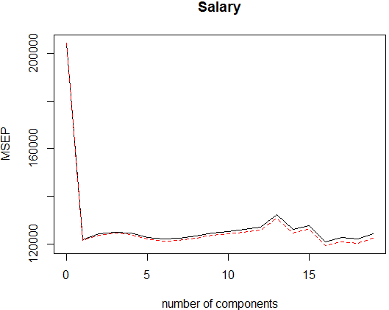
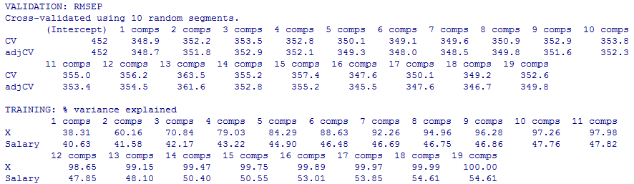

Slide 61
Code : Partial Least Squares
library (ISLR )
library (pls )
set.seed (2)
set.seed (1)
pls.fit = plsr (Salary~., data =Hitters , scale =TRUE ,validation ="CV")
summary (pls.fit )

Slide 62
